Slide 1
STEGANOGRAPHY USING PYTHON
Guided by, Presented by,
Mr Kshitiz Srivastava Tarun Verma(201710101130003)
Himesh Maurya(201710101130001)
(BCA – 61 )

Slide 2
WHAT IS STEGANOGRAPHY ?
Steganography is the art and Science of writing hidden messages in such a way that no one ,apart form the sender and intended recipient, suspect s the existence of the message.(Or Steganography is a technique of hiding communication by concealing the secret message into a fake message.)
The term Steganography has Greek influences which means “covered writing”. The main idea behind the Steganography is to prevent suspicion about the existence of the information.
ForExample:- Steganography is used by Some modern printers , including Hewlett-Packard and Xerox brand color laser printers. The printers add tiny yellow dots to each page. The barely-visible dots contain encoded printer serial numbers and date and time stamps, Alleged use by intelligence services etc.

Slide 3
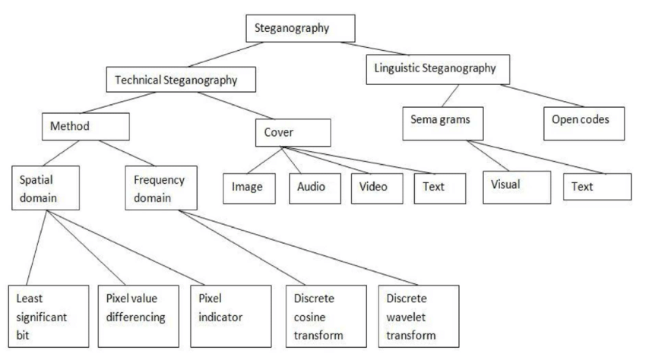
Categories of Steganography

Slide 4
Applications of Steganography
Steganography is applicable to, but not limited to, the following areas.
Confidential communication and secret data storing.
Protection of data alteration.
Access control system for digital content distribution.
Media Database systems.

Slide 5
Uses of Steganography
Clandestine Communications, blueprint, a trade secret, or else any other type of subtle data could possibly be communicated deprived of forewarning possible attackers.
Characteristics Tagging Components can be implanted within a picture.
Copyright protection methods can be used to prevent the data. The use of watermarking inside the data is mainly responsible for the rise of interest in data embedding.
Access control system for digital content distribution.
Media Database Systems.
To wrap up html pages.
Used in modern printers that contains serial numbers.

Slide 6



Technologies used
TEXT EDITOR USED :-
VISUAL STUDIO CODE
ANACONDA3
JUPYTER LAB

Slide 7
PYTHON LIBARIES USED
OPENCV
NUMPY
PANDAS
BITARRAY
TKINTER

Slide 8
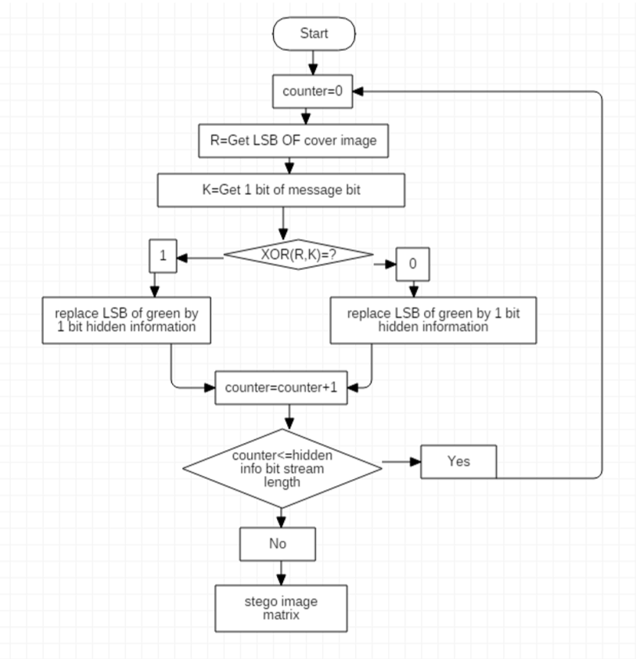
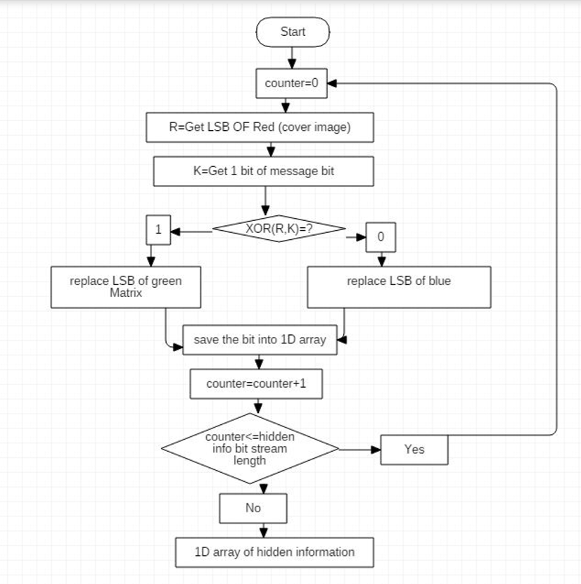
STEGANOGRAPHY MEHTODS USED
LSB(Least Significant Bit)
ENCODER DECODER

Slide 9
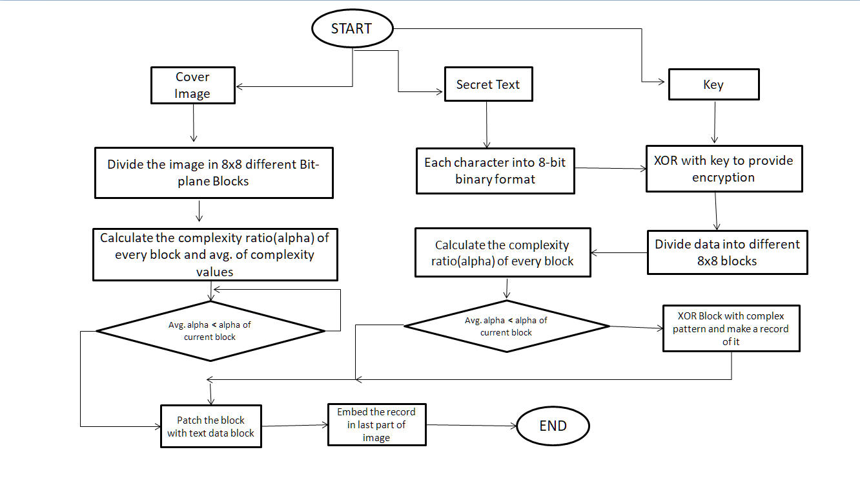
BPCS(Bit-Plane Complexity Segmentation)
ENCODER

Slide 10
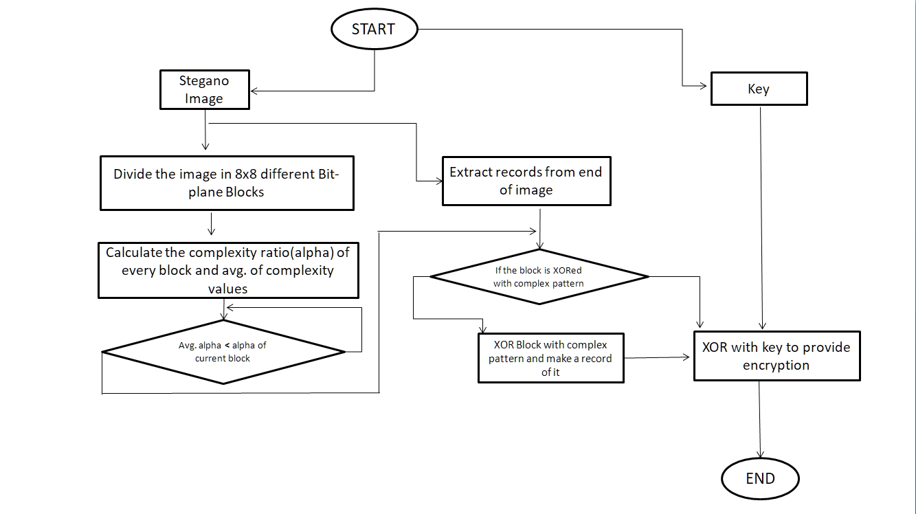
DECODER

Slide 11
LSB(Least Significant Bit)
A common approach of hiding data within an image file is Least Significant Bit (LSB) Substitution.
In this method, we can take the binary representation of the hidden data and overwrite the LSB of each byte within the cover image.

Slide 12
Least Significant Bit Substitution
Suppose we have the following binary
representation for the Cover Image.
10010101 00001101
10010110 00001111
Suppose we want to "hide" the following 4 bits of
data: 1011,
we get the following,
10010101 00001101
10010110 00001111
•
•
Where the each data bits are accommodated in
the least significant bits of each byte of the image.

Slide 13


Least Significant Bit Substitution
Least Significant Bit Substitution results in a very minor distortion of the image which is very much negligible for the human eyes.
Cover Image
Stego Image

Slide 14
BPCS(Bit-Plane Complexity Segmentation)
In this type of Steganography, noisy regions in a cover image is located and replaced by the secret message.
Noisy regions are found by simply locating the complex part of the cover image.

Slide 15
BPCS(Bit-Plane Complexity Segmentation) SUBTITUTION
Suppose we have the following Bit-plane
representation for the Cover Image.
1 1 0 1
0 1 0 1
Suppose we want to "hide" the following 8 bits of
data: 10101010,
we get the following,
1 0 1 0
1 0 1 0
Because the part of bit-plane image is complex and also the data is enough complex .hence, its completely replaced.

Slide 16

BPCS(Bit-Plane Complexity Segmentation) SUBTITUTION
Bit-Plane Complexity Segmentation Substitution results in a very minor distortion of the image which is very much negligible for the human eyes but more visible than LSB and also more capacity efficient.
Cover Image
Stegano Image

Slide 17
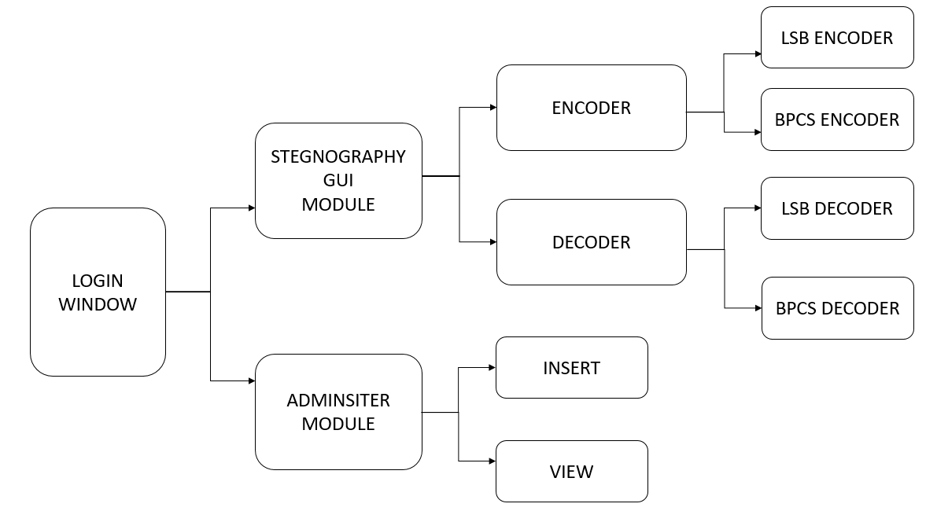
Module

Slide 18
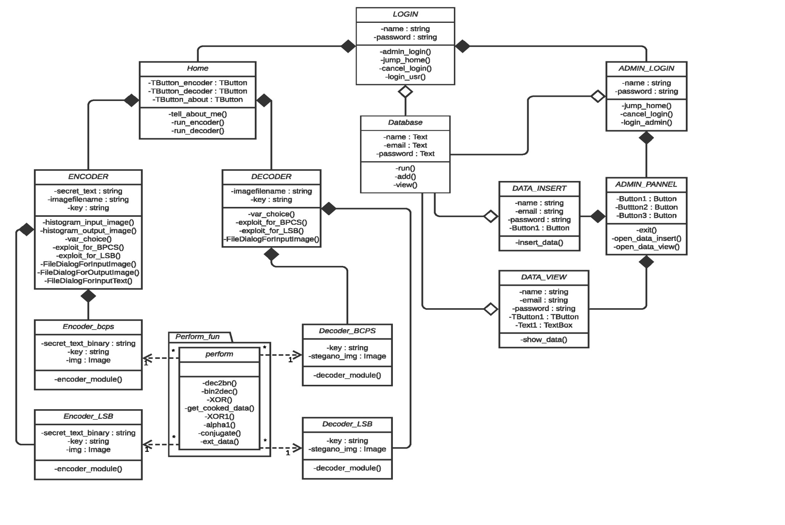
CLASS DIAGRAM

Slide 19
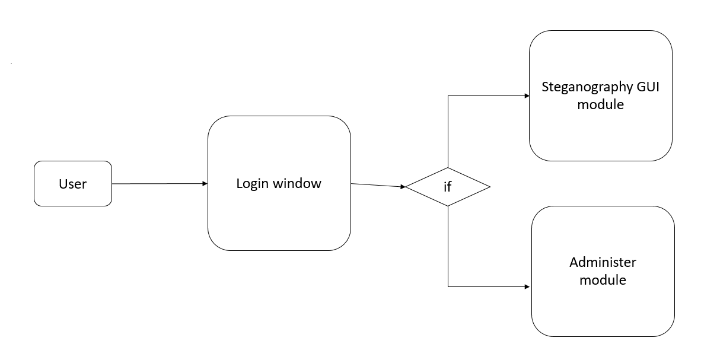
ER DIAGRAM
1

Slide 20
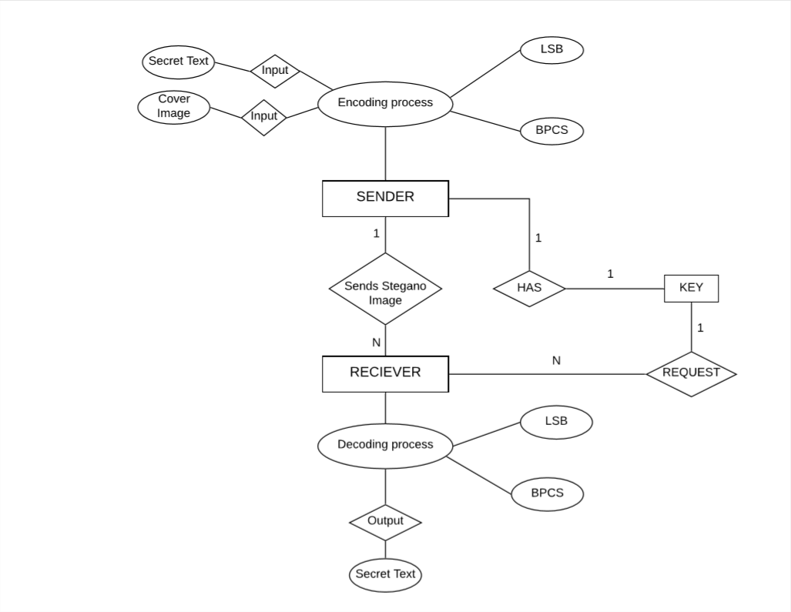
ER DIAGRAM
2

Slide 21
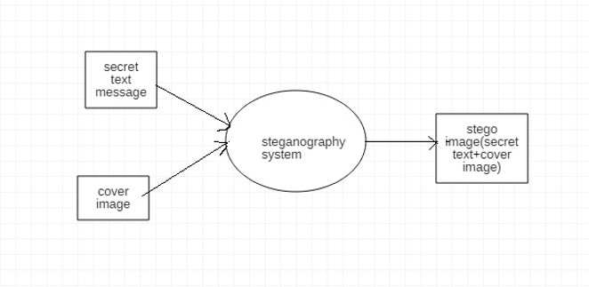
DFD(Data Flow Diagram)
Level 0 DFD

Slide 22
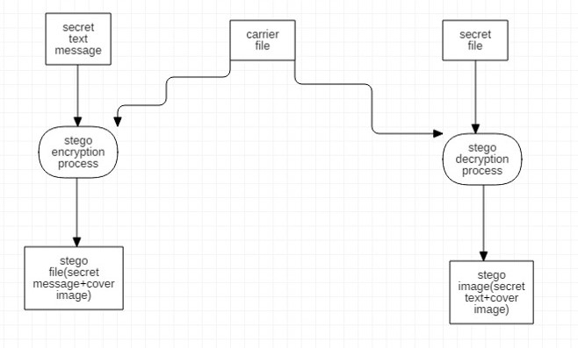
DFD(Data Flow Diagram)
Level 1 DFD

Slide 23
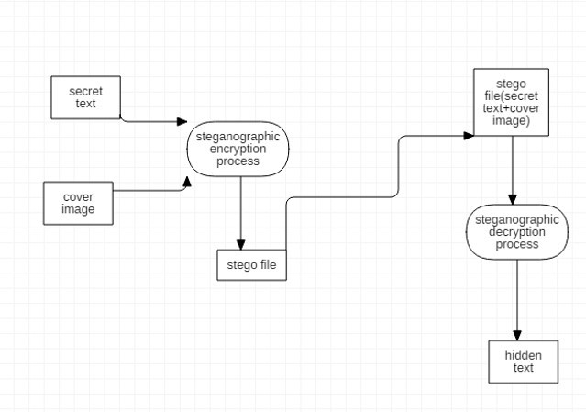
DFD(Data Flow Diagram)
Level 2 DFD

Slide 24
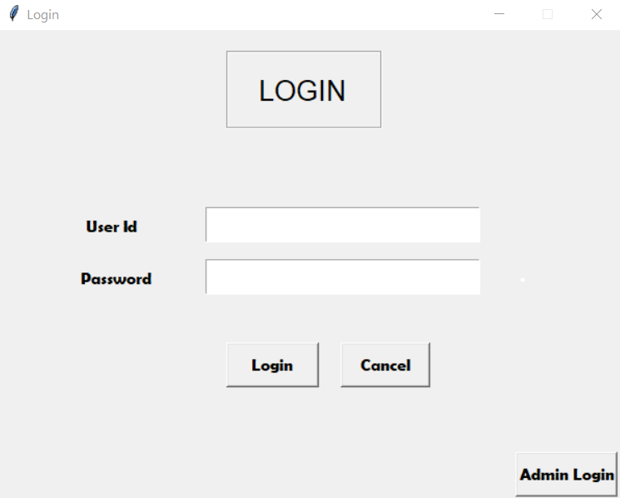
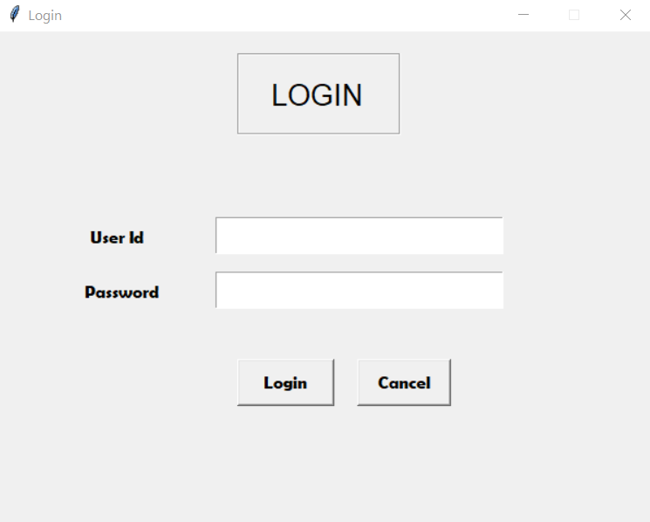
Login window
User login window
Admin login window

Slide 25
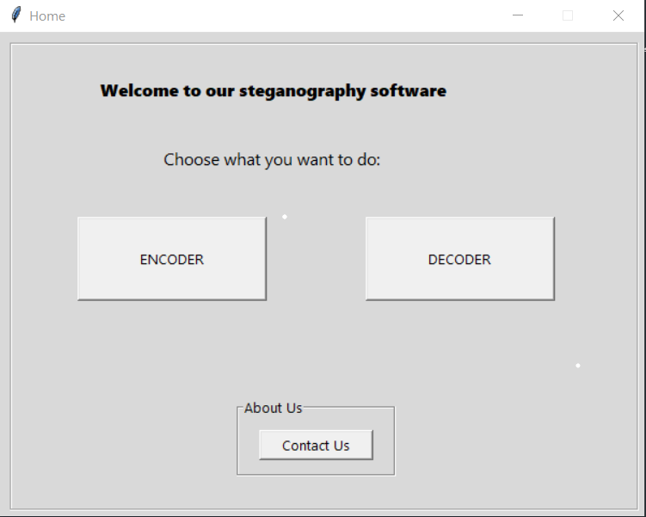
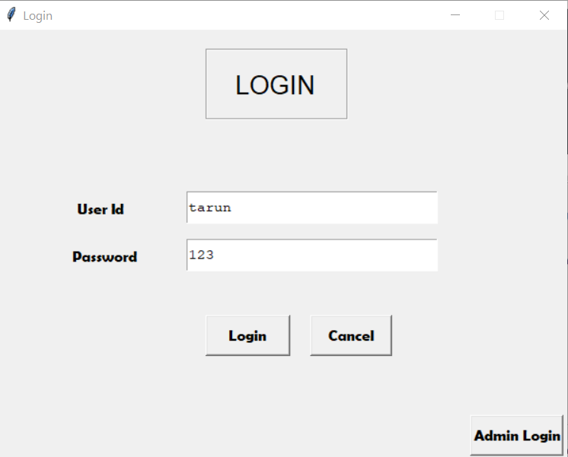
Steganography gui module
User login window
Steganography gui module

Slide 26
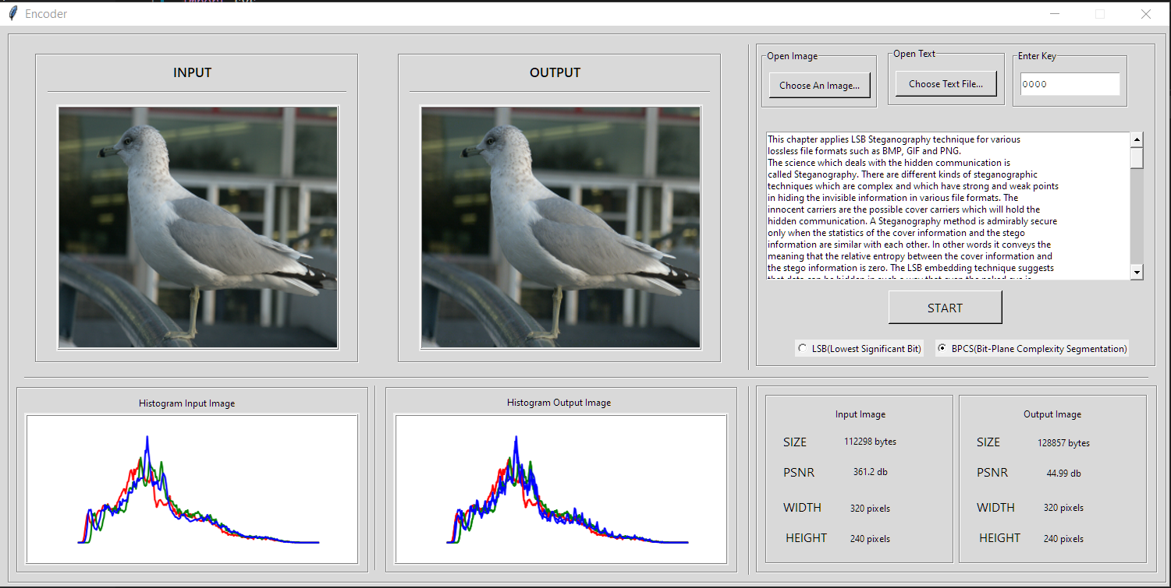
Encoder

Slide 27
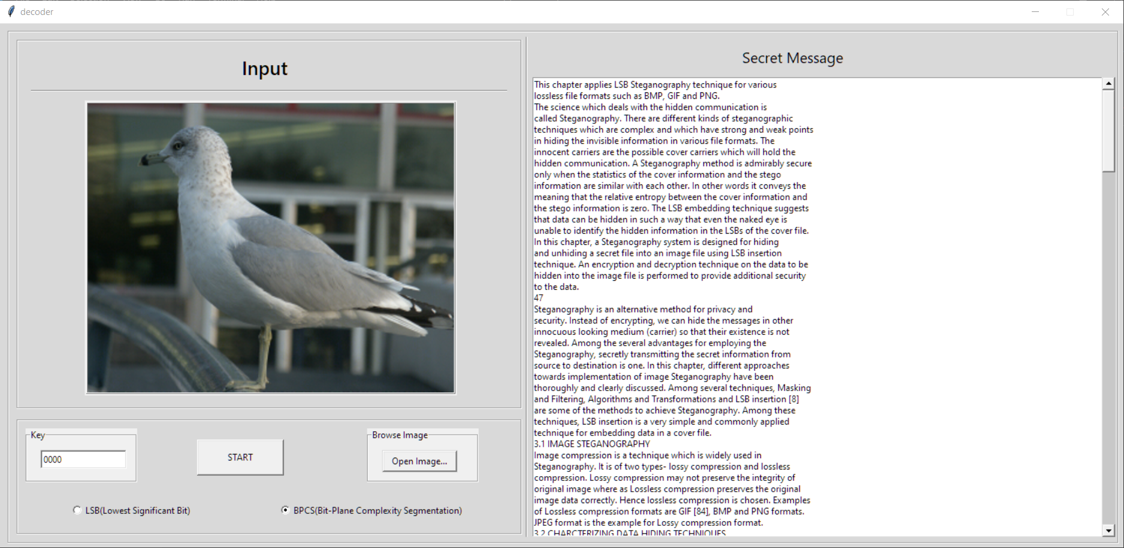
decoder

Slide 28
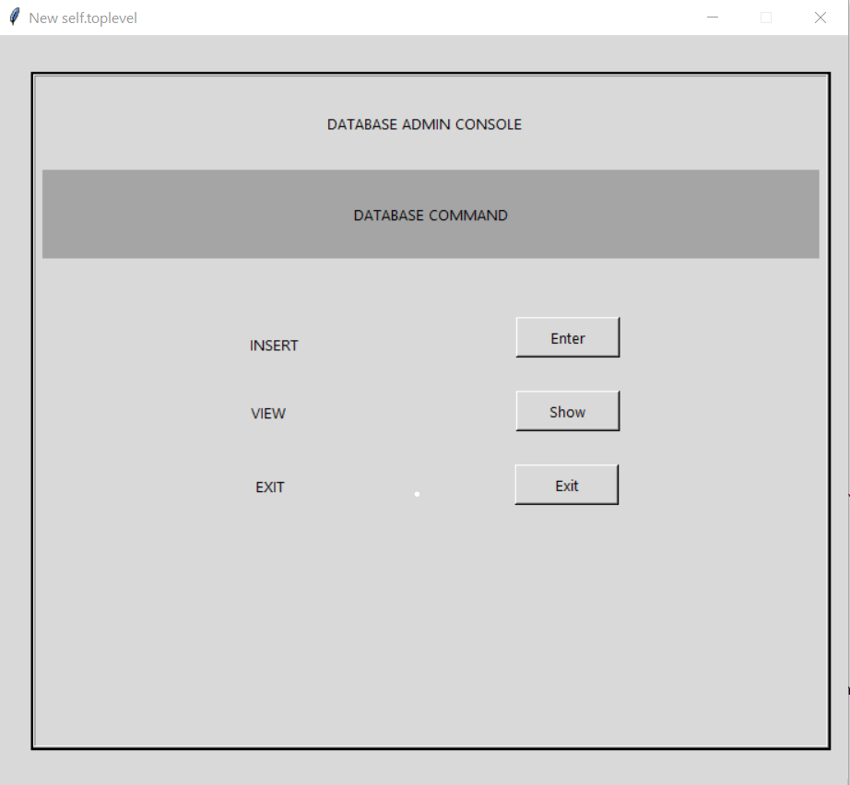
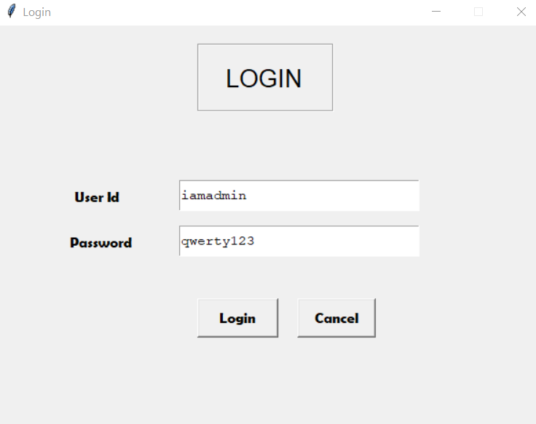
Administer module
Admin login window
DATABASE ADMIN CONSOLE

Slide 29
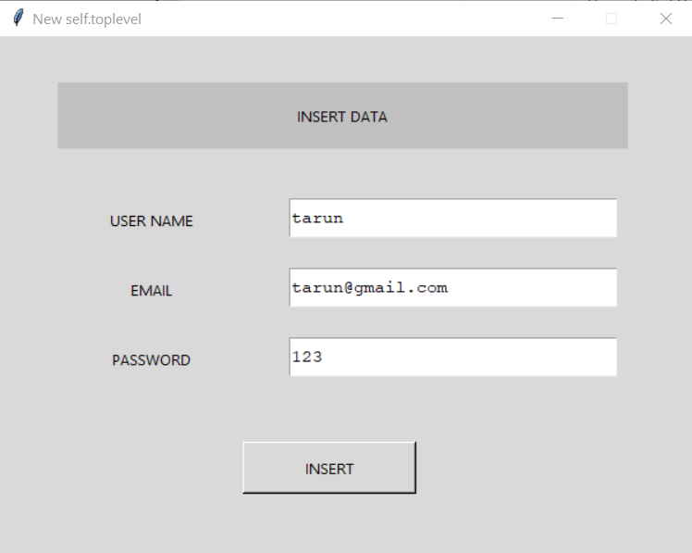
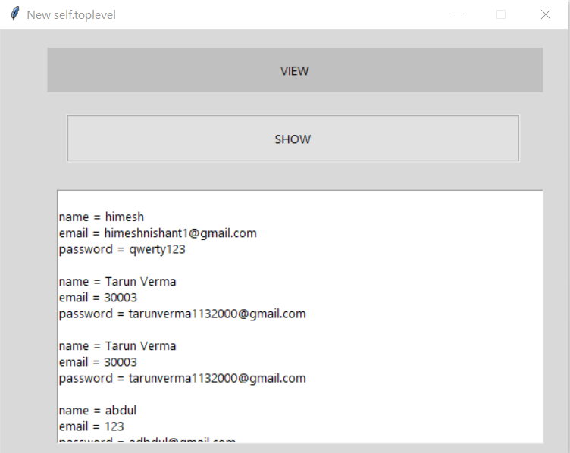
INSERT MODULE
VIEW MODULE

Slide 30
Statistics
 | COVER IMAGE | LSB | BPCS
Size of secret data | - | 12801 bytes | 12801 bytes
Image Size | 112298 bytes | 124902 bytes | 128857 bytes
PSNR | - | 54.75 db | 44.99 db

Slide 31
Project Duration
 | 15 days | 16-60 days | 61-80 Days | 81-100 days
Literature Phase
Design And Coding Phase
Testing Phase
Documentation Phase

Slide 32
Conclusion
Steganography is the art and science of writing hidden message that no one apart from the sender and receiver, suspect the existence of the message.
LSB is the simple method but BPCS is highly secured way of hiding the data in cover image. To provide high security Steganography we also provided 4 digits key option to encrypt your data.
Larger PSNR indicates the higher the image quality. A smaller PSNR means there is huge distortion between the cover-image and the stegano Image

Slide 33
Thanks You!

